Slide 1


Paul-Édouard Lainé
2024/11/15

Slide 2

Outline
Executive Summary
Introduction
Methodology
Results
Conclusion
Appendix

Slide 3
Executive Summary
Summary of methodologies
Summary of all results

Slide 4
Introduction
Project Background and Context
The commercial space age is here, with companies making space travel affordable for everyone. Notable players in this field include Virgin Galactic, Rocket Lab, Blue Origin, and SpaceX. SpaceX, in particular, has achieved significant milestones such as sending spacecraft to the International Space Station, launching the Starlink satellite internet constellation, and conducting manned missions to space. One of the key reasons for SpaceX's success is the relatively low cost of their rocket launches, primarily due to the reusability of the first stage of their Falcon 9 rockets. By determining whether the first stage will land successfully, we can estimate the cost of a launch. In this project, we will take on the role of a data scientist working for a new rocket company, Space Y, founded by billionaire industrialist Allon Musk. Our goal is to gather information about SpaceX, create dashboards for our team, and predict if SpaceX will reuse the first stage using machine learning models and public information
Problems You Want to Find Answers
Cost Estimation: Determine the price of each rocket launch by analyzing various factors that influence the cost, such as payload, orbit, and mission parameters.
First Stage Reusability: Predict whether the first stage of SpaceX's Falcon 9 rocket will land successfully and be reused. This involves training a machine learning model using public information to make accurate predictions.
Competitive Analysis: Gather and analyze information about SpaceX's operations and performance to help Space Y compete effectively in the commercial space industry.
Dashboard Creation: Develop dashboards to visualize and communicate key insights and findings to the team, aiding in decision-making and strategic planning.

Slide 5

Section 1

Slide 6
Methodology
Executive Summary
Data Collection Methodology
Describe How Data Was Collected:
Data was collected from various public sources, including SpaceX's official website, spaceflight databases, and other publicly available datasets. The data includes information on rocket launches, payloads, mission parameters, and outcomes.
Perform Data Wrangling:
Data wrangling involved cleaning and transforming the collected data to ensure consistency and accuracy. This included handling missing values, correcting data types, and merging datasets from different sources.
Describe How Data Was Processed:
The processed data was standardized and normalized to ensure that all features were on a similar scale. This step is crucial for machine learning models to perform effectively. Additionally, feature engineering was performed to create new features that could improve model performance.
Perform Exploratory Data Analysis (EDA) Using Visualization and SQL:
EDA was conducted to understand the underlying patterns and relationships in the data. Visualization tools such as Matplotlib and Seaborn were used to create plots and charts. SQL queries were used to extract and analyze specific subsets of data.
Perform Interactive Visual Analytics Using Folium and Plotly Dash:
Interactive visual analytics were performed using Folium and Plotly Dash. Folium was used to create interactive maps to visualize the geographical distribution of rocket launches. Plotly Dash was used to create interactive dashboards to visualize key metrics and trends.
Perform Predictive Analysis Using Classification Models:
Predictive analysis was conducted using various classification models, including Logistic Regression, Support Vector Machine (SVM), Decision Tree, and K Nearest Neighbors (KNN). These models were trained and evaluated to predict whether the first stage of the rocket would land successfully.
How to Build, Tune, Evaluate Classification Models:
Build: Classification models were built using scikit-learn, a popular machine learning library in Python.
Tune: Hyperparameter tuning was performed using GridSearchCV to find the best parameters for each model.
Evaluate: The models were evaluated using metrics such as accuracy, precision, recall, and the confusion matrix. Cross-validation was used to ensure the models' robustness and generalizability.

Slide 7
Data Collection
Data Collection Methodology
Public Sources: Data was collected from various public sources, including SpaceX's official website, spaceflight databases, and other publicly available datasets. These sources provided comprehensive information on rocket launches, payloads, mission parameters, and outcomes.
APIs and Web Scraping: APIs and web scraping techniques were used to gather data from online sources. For example, APIs provided by spaceflight tracking websites were utilized to fetch real-time data on rocket launches and their outcomes. Web scraping was employed to extract data from websites that did not offer APIs.
Historical Data: Historical data on rocket launches and their outcomes were obtained from spaceflight archives and databases. This data included detailed records of past missions, including launch dates, payloads, mission objectives, and whether the first stage was successfully recovered.
Data Integration: The collected data from various sources were integrated into a unified dataset. This involved merging data from different sources, ensuring consistency in data formats, and resolving any discrepancies.
Data Validation: The collected data was validated to ensure accuracy and reliability. This involved cross-referencing data from multiple sources, checking for inconsistencies, and correcting any errors.

Slide 8
Data Collection – SpaceX API
SPACE X API
Request and parse the SpaceX launch data using the GET request
Display the first few rows of the DataFrame
Filter the dataframe to only include Falcon 9 launches
Data Wrangling
Dealing with Missing Values

Slide 9
Data Collection - Scraping
WEB SCRAPING
Request the Falcon9 Launch Wiki page from its URL
Extract all column/variable names from the HTML table header
Create a data frame by parsing the launch HTML tables

Slide 10
Data Wrangling
Data wrangling
Data cleaning by removing duplicates, handling missing values and correct data types
Data transformation by standardizing and normalizing the data to ensure consistency
Feature engineering by creating new features to improve model performance.
Data splitting into training and test sets fr model evaluation
TASK 1: Calculate the number of launches on each site
TASK 2: Calculate the number and occurrence of each orbit
TASK 3: Calculate the number and occurence of mission outcome of the orbits
TASK 4: Create a landing outcome label from Outcome column

Slide 11
EDA with Data Visualization
Scatter graph
The scatter plot was chosen to present the relation between the payload mass and the flight number. We can see the progression of the flights and the success or failure depending the mass. In a second graph, we can see what location has the most success as the number of flights goes up
Bar chart
The linear graph was to display the average success rate over the years
The bar chart was chosen to display what orbit type was the most successful
Linear graph
EDA VISUALIZATION

Slide 12
EDA with SQL
EDA_SQL
Display the names of the unique launch sites in the space mission
Display 5 records where launch sites begin with the string 'CCA'
Display the total payload mass carried by boosters launched by NASA (CRS)
Display average payload mass carried by booster version F9 v1.1
List the date when the first succesful landing outcome in ground pad was acheived.
List the names of the boosters which have success in drone ship and have payload mass greater than 4000 but less than 6000
List the total number of successful and failure mission outcomes
List the names of the booster_versions which have carried the maximum payload mass. Use a subquery
List the records which will display the month names, failure landing_outcomes in drone ship ,booster versions, launch_site for the months in year 2015.
Rank the count of landing outcomes (such as Failure (drone ship) or Success (ground pad)) between the date 2010-06-04 and 2017-03-20, in descending order.

Slide 13
Build an Interactive Map with Folium
On the interactive maps, I added markers, lines and numbers for mutltiples reasons
Markers: To see where are the launch sites and NASA
Lines: To see how close are the launch sites from the coastlines and cities
Numbers: Display the number of launches from launch sites that are in the same vicinity
Map Link

Slide 14
Build a Dashboard with Plotly Dash
The plots and charts used are the pie chart and scatter plot
The pie chart: to display the number of successful and failed launches from either all sites or each sites separately
The scatter plot: Dispalying what version of the Booster succeed or failed depending of the payload range with the aid of a slider that changes the slider ranging from 0 to 10000kg
Dashboard
Dash Git Hub

Slide 15
Predictive Analysis (Classification)
Create a NumPy array from the column Class in data,
Standardize the data in X then reassign it to the variable X
Use the function train_test_split to split the data X and Y into training and test data. Set the parameter test_size to 0.2 and random_state to 2.
Create a logistic regression object then create a GridSearchCV object with cv = 10.
Calculate the accuracy on the test data using the method
Create a support vector machine object then create a object with cv = 10
Calculate the accuracy on the test data using the method
Create a decision tree classifier object then create a object with cv = 10.
Calculate the accuracy of tree_cv on the test data using the method
Create a k nearest neighbors object then create a object with cv = 10
Calculate the accuracy of knn_cv on the test data using the method
Find the method performs best:
We built and evaluated four classification models: Logistic Regression, Support Vector Machine (SVM), Decision Tree, and K Nearest Neighbors (KNN). Each model was tuned using GridSearchCV to find the best hyperparameters. All models achieved the same test accuracy of 0.8333. Further analysis using additional metrics such as precision, recall, and the confusion matrix could provide more insights into the performance of each model. Overall, the models performed well, and any of them could be a suitable choice for this classification task.
Predictive Analysis

Slide 16
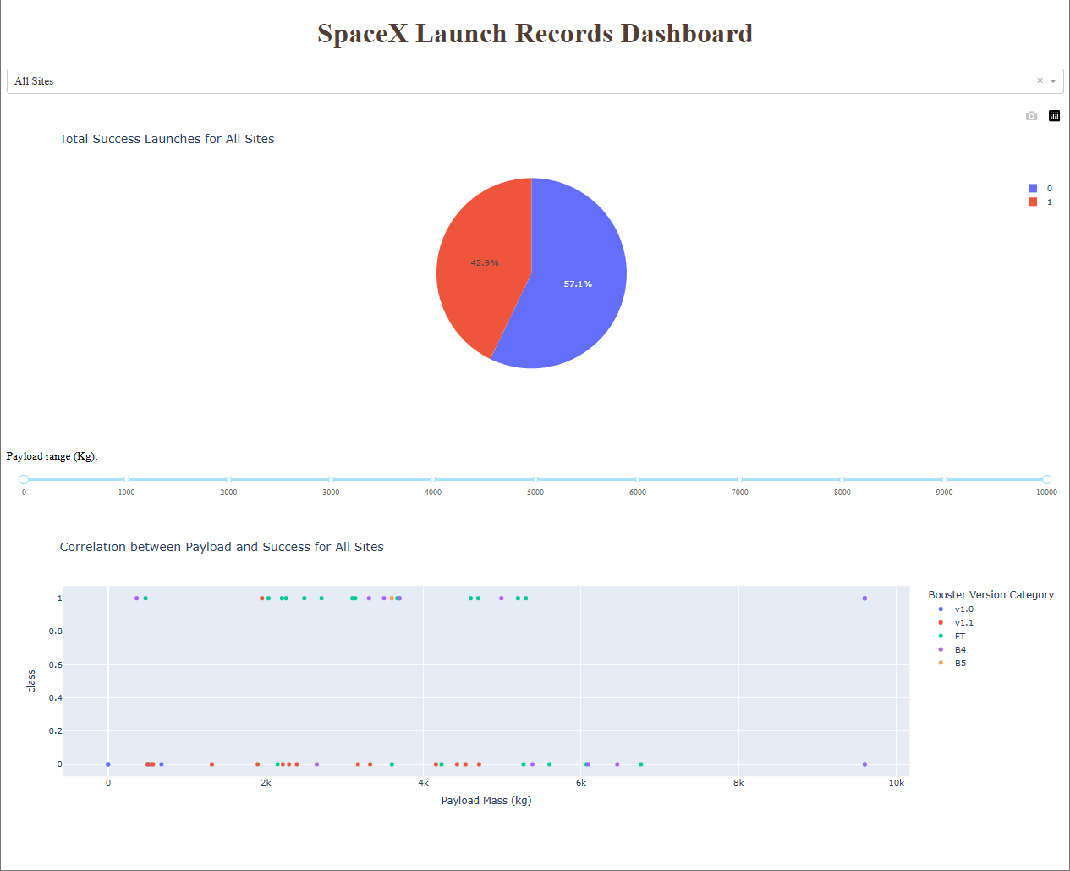
Results
Exploratory Data Analysis Results
Unique Launch Sites: Identified the unique launch sites in the space mission dataset, which include 'CCAFS LC-40', 'VAFB SLC-4E', 'KSC LC-39A', and 'CCAFS SLC-40'.
Launch Sites Starting with 'CCA': Displayed 5 records where launch sites begin with the string 'CCA', showing details, such as launch date, booster version, payload, and mission outcome.
Total Payload Mass by NASA (CRS): Calculated the total payload mass carried by boosters launched by NASA (CRS), which amounted to 45,596 kg.
Average Payload Mass by Booster Version F9 v1.1: Calculated the average payload mass carried by booster version F9 v1.1, which was 2,928.4 kg.
First Successful Ground Pad Landing: Identified the date of the first successful landing outcome on a ground pad, which was achieved on 2015-12-22.
Boosters with Successful Drone Ship Landings and Specific Payload Mass: Listed the names of boosters that had successful landings on a drone ship and carried payloads between 4,000 and 6,000 kg. The boosters included F9 FT B1022, F9 FT B1026, F9 FT B1021.2, and F9 FT B1031.2.
Mission Outcomes: Counted the total number of successful and failure mission outcomes, with 98 successes, 1 failure (in flight), 1 success (payload status unclear), and 1 success.
Boosters with Maximum Payload Mass: Listed the booster versions that carried the maximum payload mass, including F9 B5 B1048.4, F9 B5 B1049.4, F9 B5 B1051.3, and others.
Failure Landing Outcomes in 2015: Displayed records of failure landing outcomes on drone ships in 2015, including details such as month, booster version, and launch site.
Ranked Landing Outcomes: Ranked the count of landing outcomes between 2010-06-04 and 2017-03-20 in descending order. The outcomes included 'No attempt', 'Success (drone ship)', 'Failure (drone ship)', and others.
Logistic Regression
Support Vector Machine (SVM)
Best Parameters: {'C': 1.0, 'gamma': 0.03162277660168379, 'kernel': 'sigmoid'}
Decision Tree
Best Parameters: {'C': 0.01, 'penalty': 'l2', 'solver': 'lbfgs'}
Best Parameters: {'algorithm': 'auto', 'n_neighbors': 10, 'p': 1}
Best Parameters: {'criterion': 'gini', 'max_depth': 2, 'max_features': 'sqrt', 'min_samples_leaf': 2, 'min_samples_split': 2, 'splitter': 'random'}
K Nearest Neighbors(KNN)
Validation Accuracy: 0.8482
Test Accuracy: 0.8333
Validation Accuracy: 0.8768
Test Accuracy: 0.8333
Validation Accuracy: 0.8482
Test Accuracy: 0.8333
Validation Accuracy: 0.8464
Test Accuracy: 0.8333

Slide 17

Section 2

Slide 18
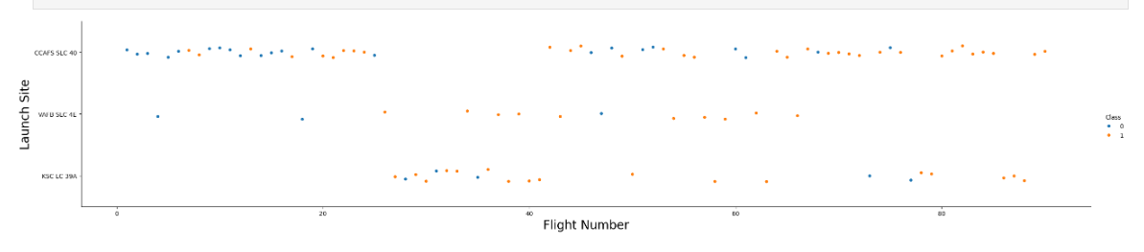
Flight Number vs. Launch Site
The CCAF SLC 40 had the most launches therefore the most failed launches. We can see a stronger concentration of failures in the earlier flights

Slide 19
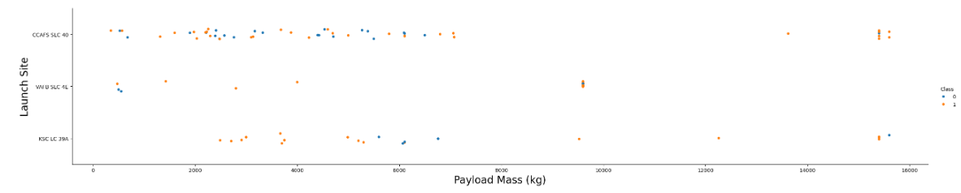
Payload vs. Launch Site
It seems that when the payload is below 8000kg, it has higher chance to fail but it’s most likely tied to the fact that most flight were under that payload

Slide 20
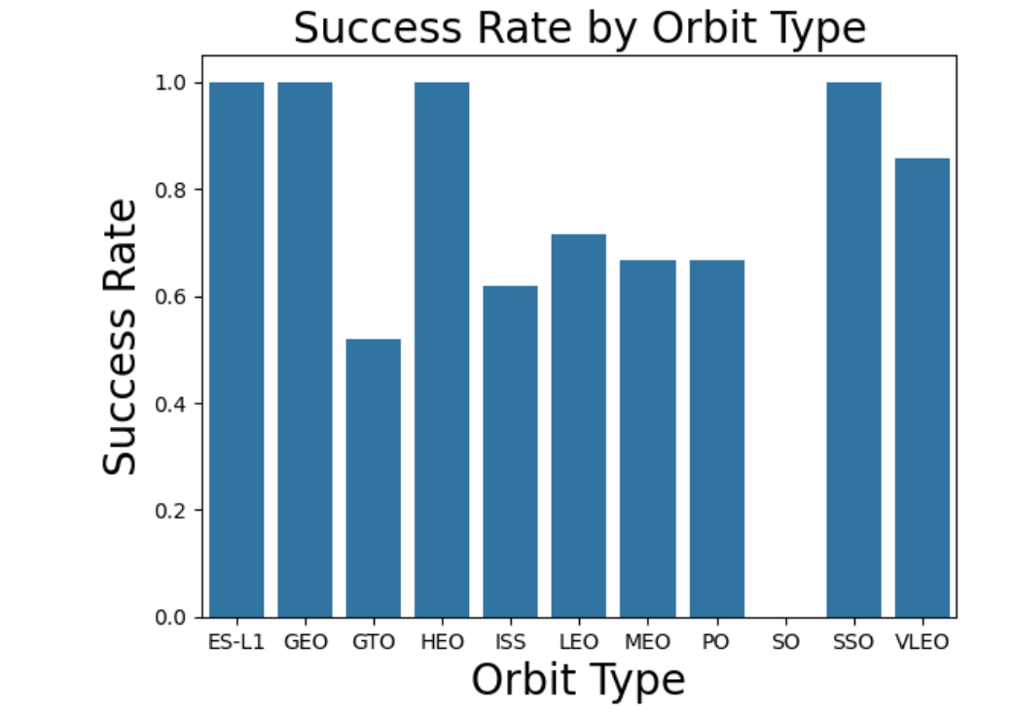
Success Rate vs. Orbit Type
Outside of GTO, most of them have over 60% success rate in launches

Slide 21
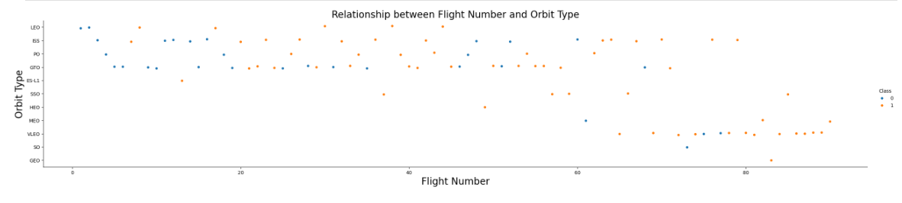
Flight Number vs. Orbit Type
The orbit types LEO, ISS, PO, GTO have the most flights. It explains their higher failures compared to the other types of orbit.

Slide 22
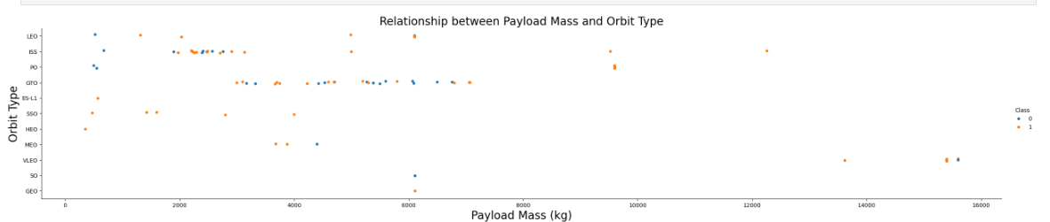
Payload vs. Orbit Type
Most flights were under 8000KG payload. Between 0 and 2000kg, the orbit LEO, ISS and PO have mostly failed. The flights above 8000kg are very rare with much less failure.

Slide 23
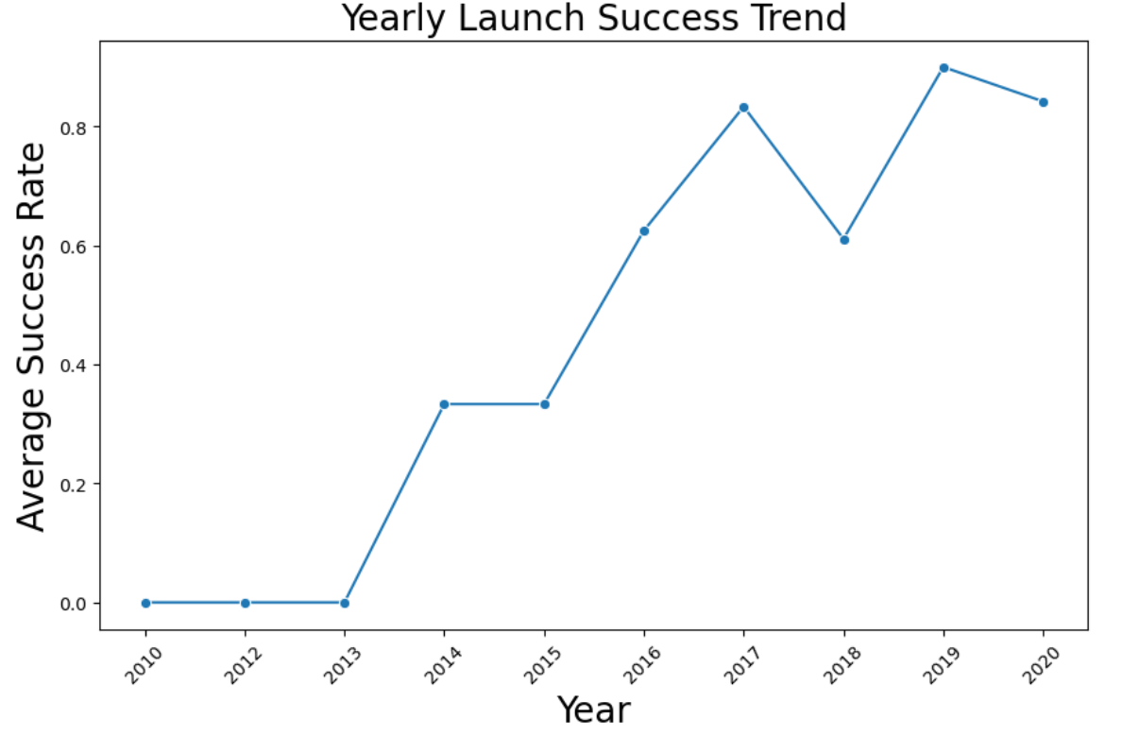
Launch Success Yearly Trend
The success rate goes up as the years goes by

Slide 24
All Launch Site Names
(
'CCAFS LC-40',) ('VAFB SLC-4E',) ('KSC LC-39A',) ('CCAFS SLC-40’,)
This is the code I used to get the launch sites:
# Run the SQL query
result = %sql SELECT * FROM SPACEXTABLE WHERE Launch_Site LIKE 'CCA%' LIMIT 5;
# Display the result in a readable format
if result:
for row in result:
print(row)
else:
print("No results found.")
The reason i used this code was to get unique launch sites in the list and not duplicates. I put a limit at 5.

Slide 25
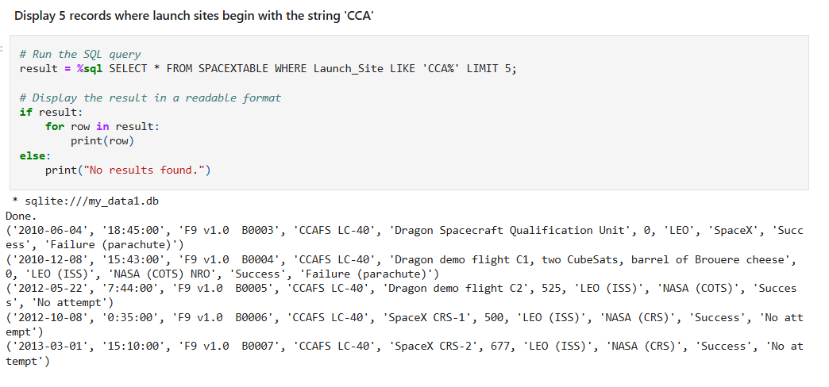
Launch Site Names Begin with 'CCA'

Slide 26
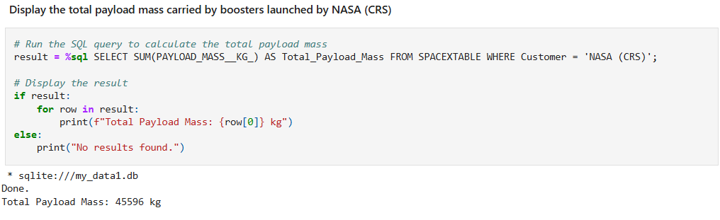
Total Payload Mass

Slide 27
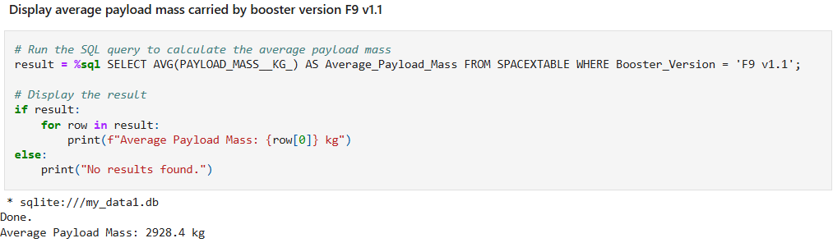
Average Payload Mass by F9 v1.1

Slide 28
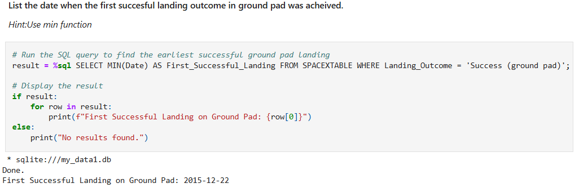
First Successful Ground Landing Date

Slide 29
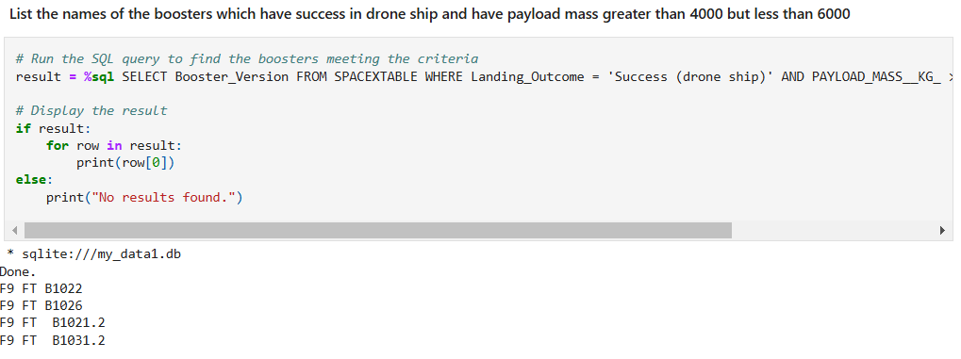
Successful Drone Ship Landing with Payload between 4000 and 6000

Slide 30
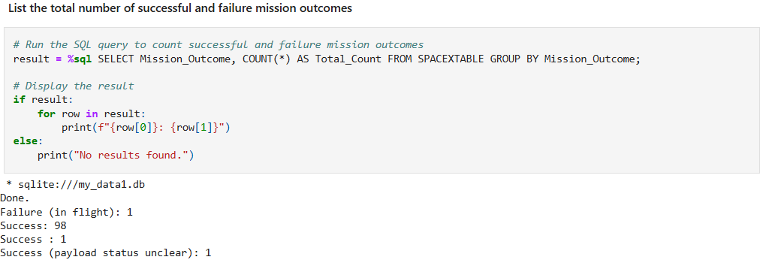
Total Number of Successful and Failure Mission Outcomes

Slide 31
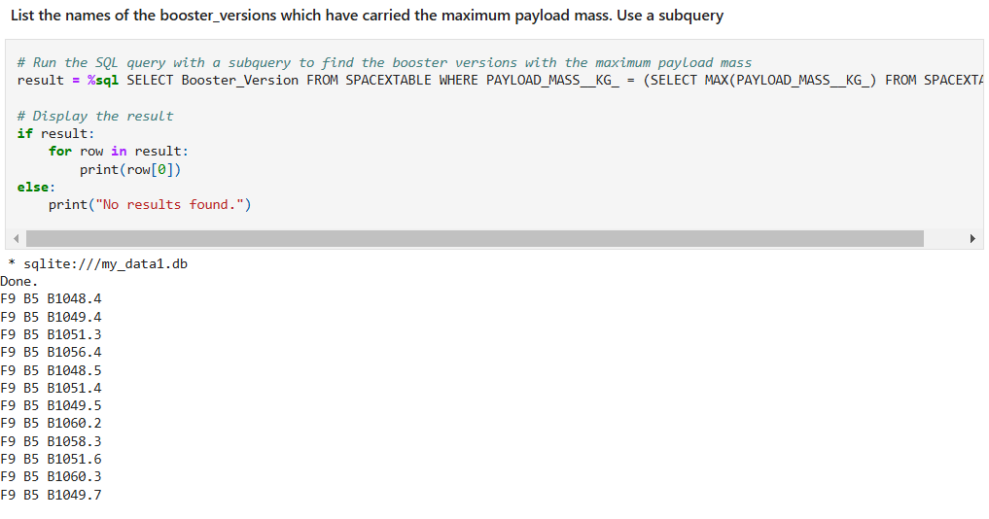
Boosters Carried Maximum Payload

Slide 32
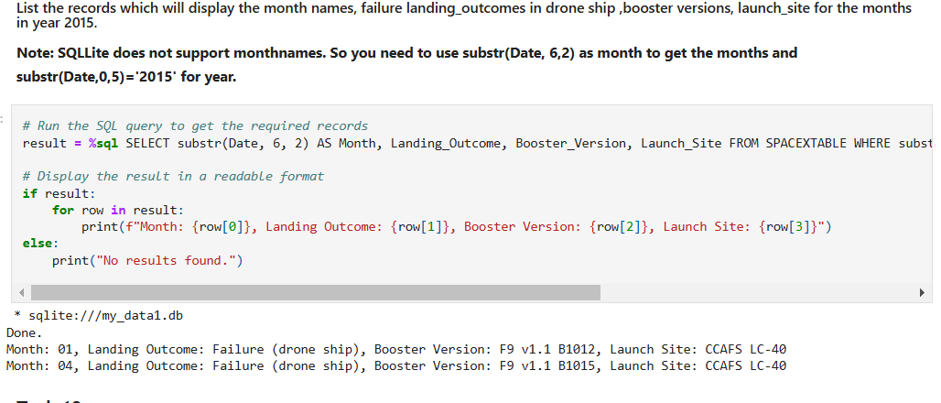
2015 Launch Records

Slide 33
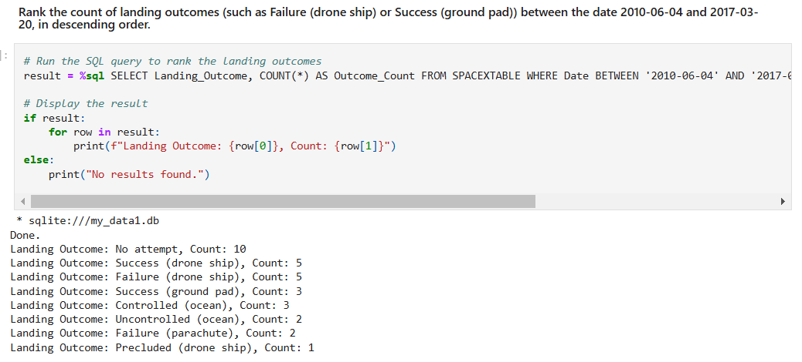
Rank Landing Outcomes Between 2010-06-04 and 2017-03-20

Slide 34

Section 3

Slide 35
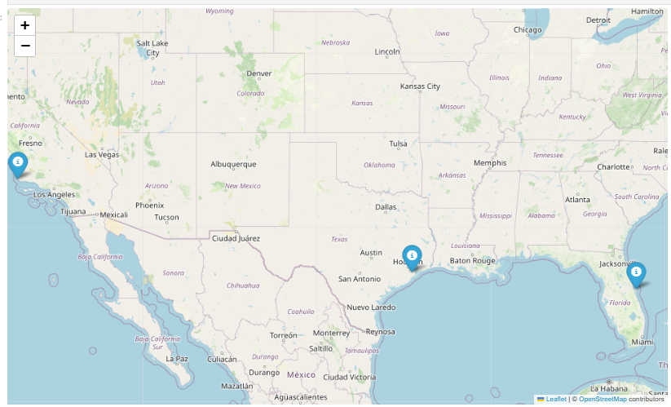
Launch Sites Map Markers
The markers on the map are the NASA and the launch sites in California and Florida

Slide 36
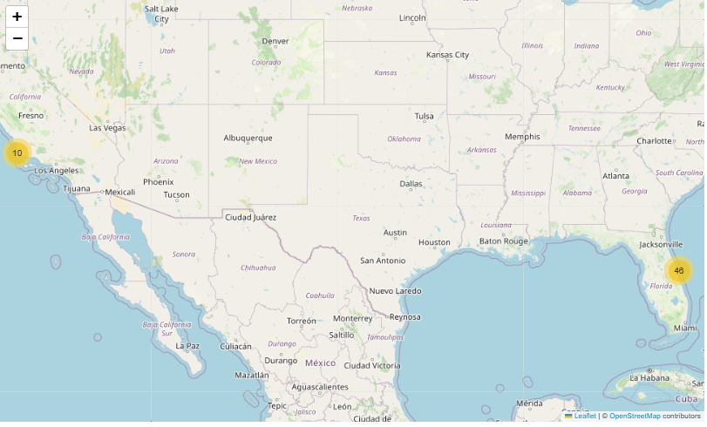
Map with successful and failed laucnhes
The numbers on the map are the numbers of launches from a certain radius. We can see that Florida has the most launches

Slide 37
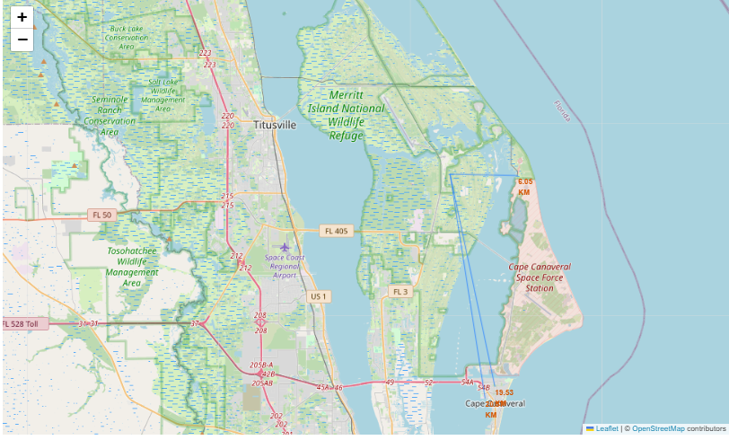
Map with proximities
The lines are starting from Launch Site. They’re connecting to the closest coastline and nearest city

Slide 38

Section 4

Slide 39
Dashboard Pie Chart
As we can see, more than 50% of the launches succeeded.

Slide 40
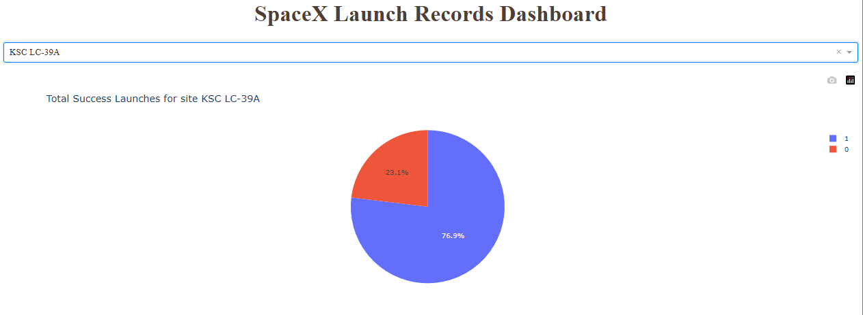
Dashboard Pie Chart highest success rate site
The KSC LC 39A is the launch site with the highest success rate compared to the other sites. Almost 80%

Slide 41
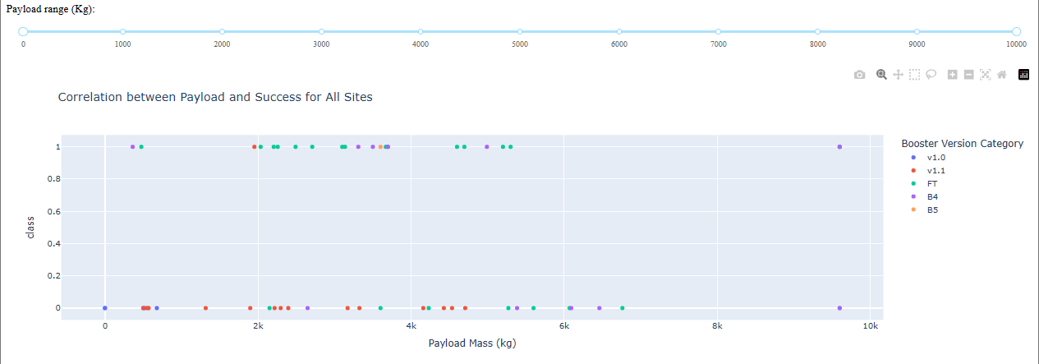
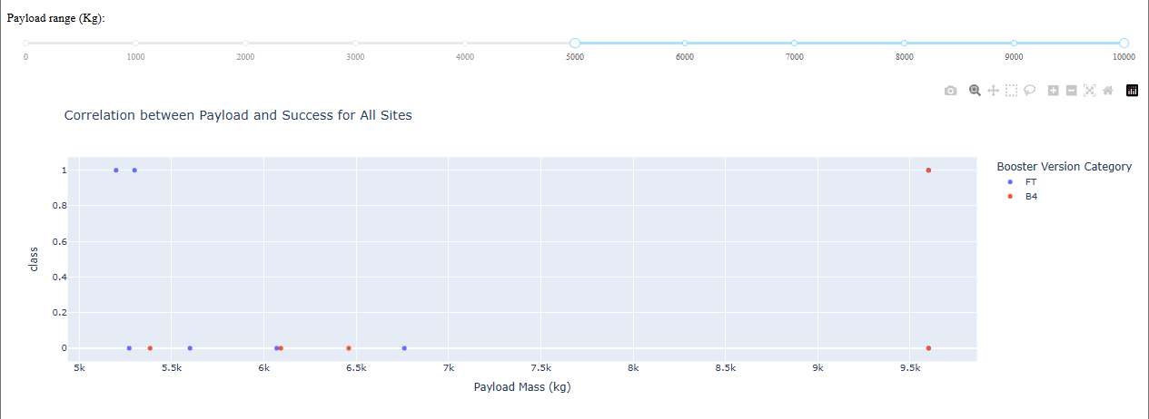
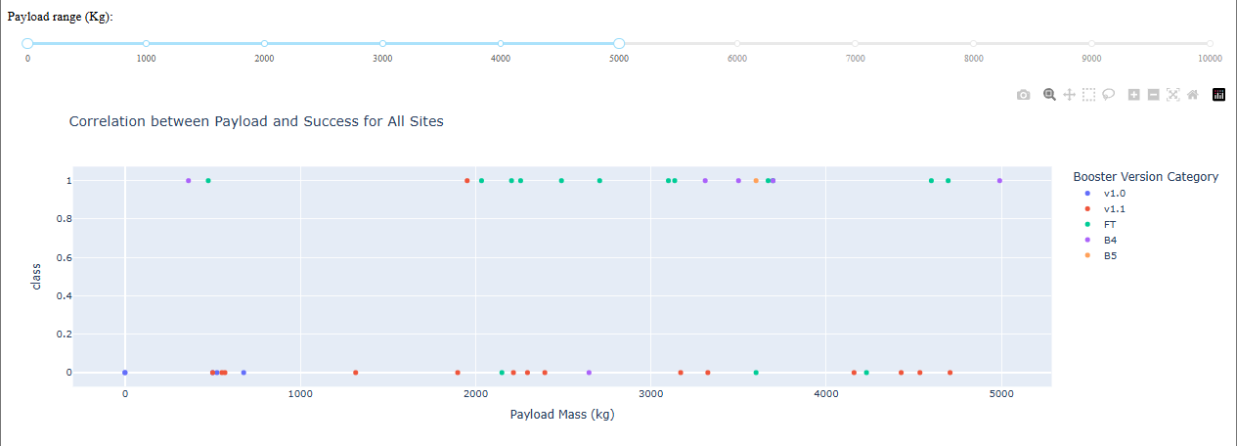
Dashboard Scatter Plot payload vs launch outcome

Slide 42

Section 5

Slide 43
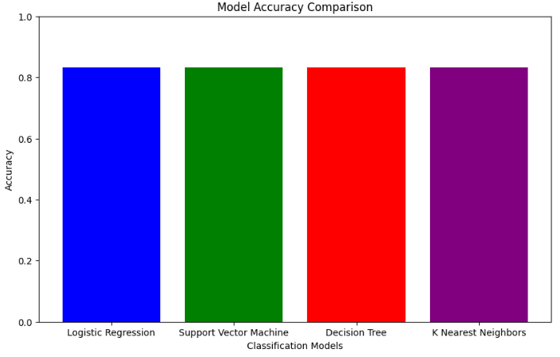
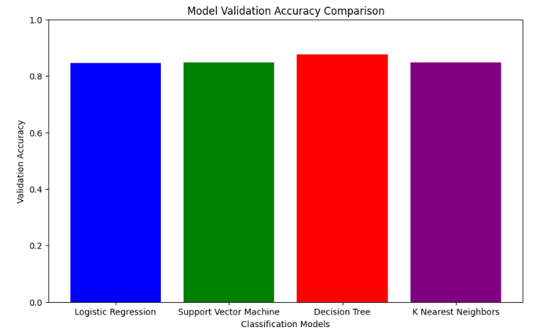
Classification Accuracy
The model accuracy is all the same, all at 83%. The model validation accuracy is quite similar but the decision tree is slighly higher than the others

Slide 44
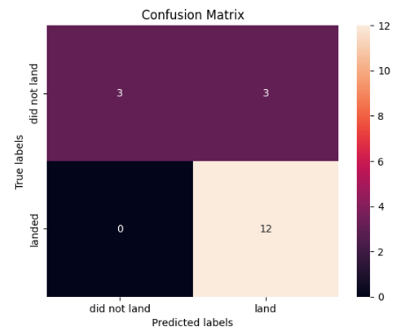
Confusion Matrix

Slide 45
Conclusions
The launches success went higher as the years goes by
The success depend on the payload and the orbit type
The models are very similar with high accuracy
The launch sites are fairly far from cities, railrays and close to coastlines

Slide 46
Appendix
Include any relevant assets like Python code snippets, SQL queries, charts, Notebook outputs, or data sets that you may have created during this project
import matplotlib.pyplot as plt# Model names and their accuraciesmodels = ['Logistic Regression', 'Support Vector Machine', 'Decision Tree', 'K Nearest Neighbors']accuracies = [0.8333, 0.8333, 0.8333, 0.8333]# Create a bar chartplt.figure(figsize=(10, 6))plt.bar(models, accuracies, color=['blue', 'green', 'red', 'purple'])plt.xlabel('Classification Models')plt.ylabel('Accuracy')plt.title('Model Accuracy Comparison')plt.ylim(0, 1)plt.show()

Slide 47


